Slide 1

Devnet Certification Study Group
A League of Extraordinary Engineers

Slide 2

Purpose
Create a cohort of interested engineers to blaze the trail to certification success
Leverage herd mentality
Drive engagement, encourage accountability
Foster team growth

Slide 3
Structure
Pacific (PST/PDT) / AZ Summer (MST) | Mountain (MST/MDT) / AZ Winter (MST) | Central | Eastern
10:00 AM | 11:00 AM | 12:00 PM | 1:00 PM
Weekly, 11am MST (GMT-7)
Note timezone changes
Alternating presenters for review,
1) Visbility, cross functional give back
2) immersion, you will retain that subject best when forced to retell the message

Slide 4
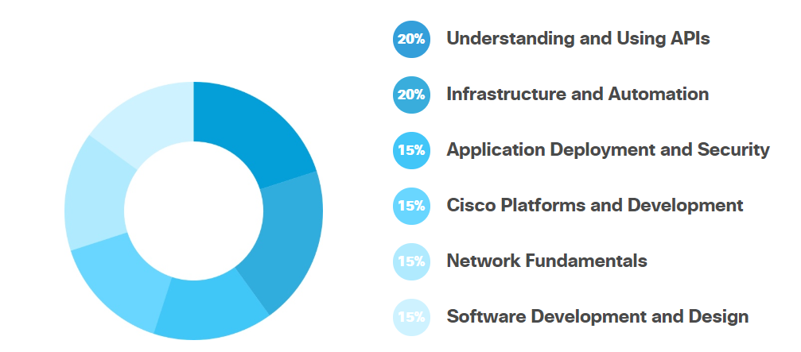
Knowledge domains
https://developer.cisco.com/certification/devnet-associate/

Slide 5
Syllabus/Logistics
Date | Topic
7/31 | Kickoff – Dev environment, Github
8/7 | Module 1 – 1.1-1.8
8/14 | Module 2 : 2.1-2.9
8/21 | Module 3.1 – 3.5
8/28 | Mod 3.6+
9/4 | Mod 4.1-4.5
9/11 | 5.X
9/18 | 5.X.2
Tools:
Teams room
Quizlet
Friday meeting
Devnet Curriculum
Hands on quick labs

Slide 6
Mod 1

Slide 7
Quizlet/ Teams Space
https://quizlet.com/join/jHjt92pgt - join my class
https://eurl.io/#S1CD38ZCr Join the webex teams space

Slide 8
First part of training
What is a Development Environment and why do you need one?
A brief introduction to Git
Intro to Python Part 1
Intro to Python Part 2
Coding 202: Parsing JSON using Python
Introduction to XML
Introduction to the Guest Shell

